Slide 1
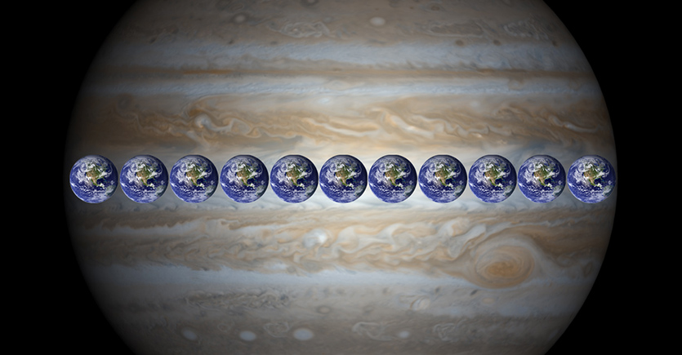
The Solar System
2017

Slide 2
Solar System
Our solar system was created about 5 billion years ago when an average sized star (Sun) began it’s life by nuclear fusion.
Our solar system includes the following:
SUN: a main sequence star
Objects revolving around the Sun: these are materials blown outward from the original formation of our Sun, and are still connected by GRAVITY to the Sun and therefore in ORBIT around the SUN, in elliptical orbits (more on this later)…

Slide 3
Planets
Terrestrial Planets = the smaller, INNERMOST, ROCKY planets closest to the Sun, including MERCURY, VENUS, EARTH and MARS
Jovian Planets = the larger, OUTERMOST, GASEOUS planets that were blown further away from the Sun, including JUPITER, SATURN, URANUS, AND NEPTUNE
Dwarf Planets = Similar to planets, but share orbits around the Sun with other objects such as asteroids or comets. Dwarf planets include Pluto, Ceres, Eris, Haumea, and Makemake

Slide 4
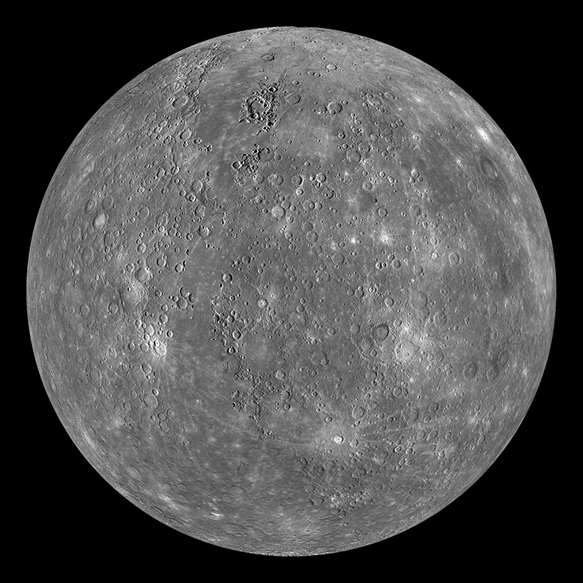
Mercury

Slide 5
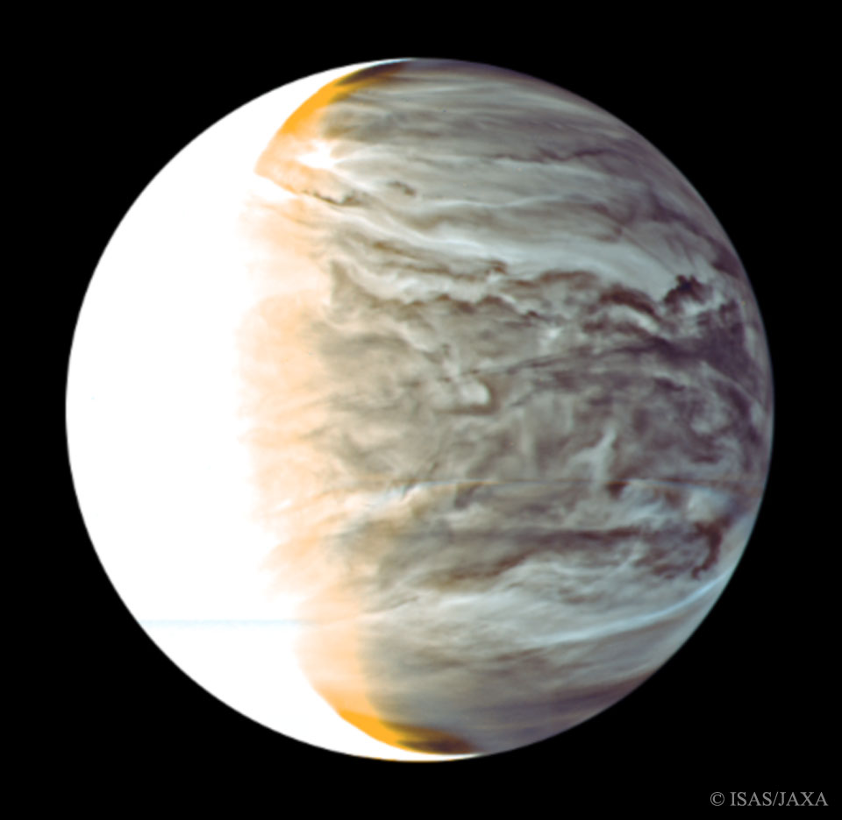
Venus

Slide 6
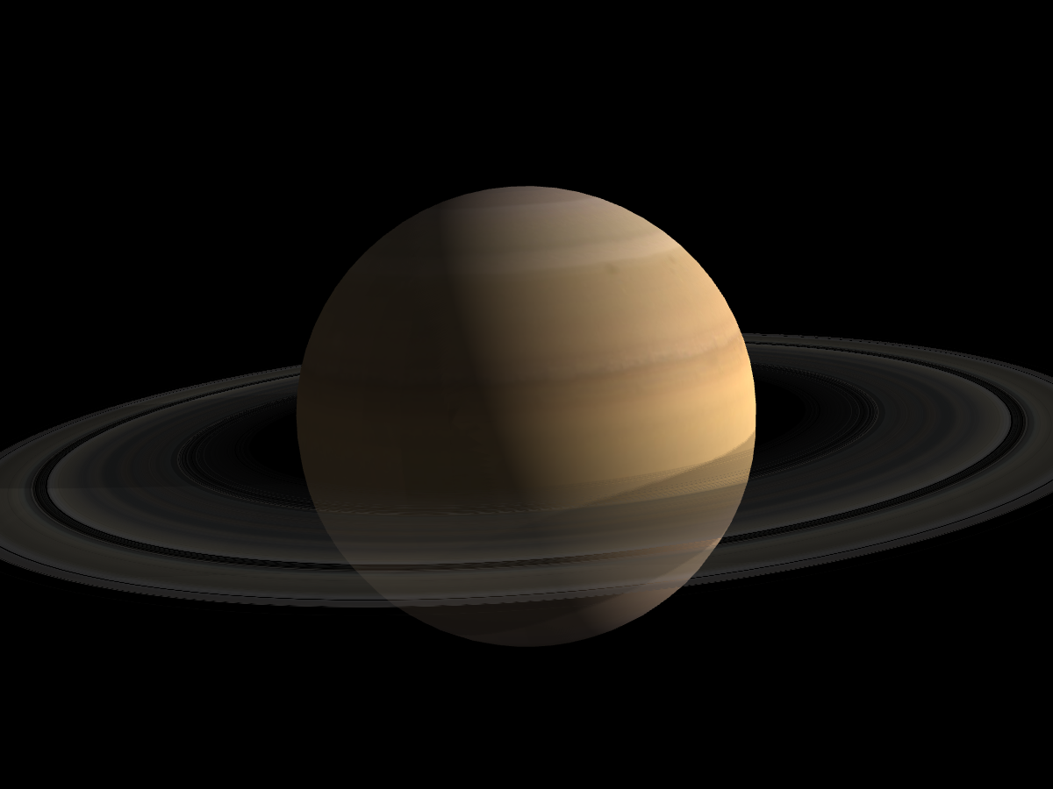
Saturn

Slide 7
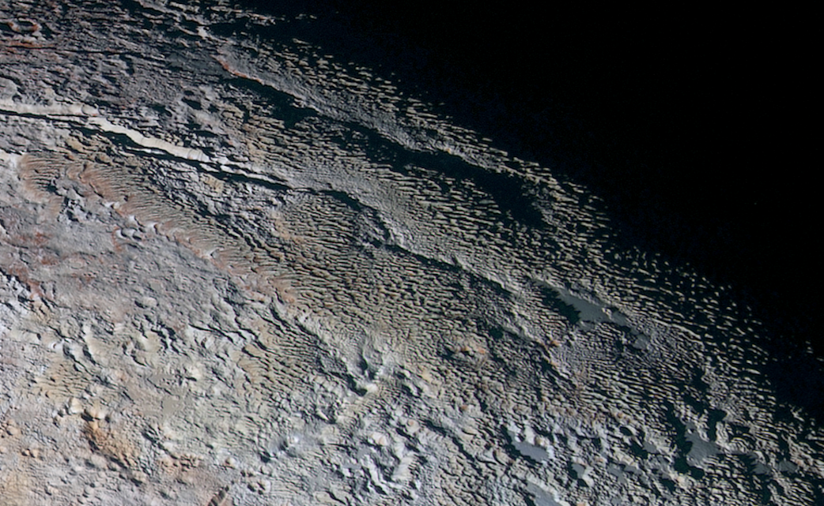
The surface of Pluto

Slide 8
Other Revolving Objects:
Asteroids = relatively small, inactive, rocky body orbiting the Sun. Most are between the orbits of Mars and Jupiter
Comets = relatively small, at times active, objects whose ices can vaporize in sunlight forming an atmosphere of dust and gas and, sometimes, a tail of dust and/or gas.
Meteoroids = small particles from a comet or asteroid orbiting the Sun.
Meteors = the light phenomenon which results when a meteoroid enters the Earth's atmosphere and vaporizes; (called a “shooting star”).
Meteorites = meteoroids that survive passage through the Earth's atmosphere and land upon the Earth's surface.

Slide 9
Solar System:
Planets and their satellites (moons) REVOLVE around the Sun, with the Sun located at one FOCAL POINT of an ellipse.
Asteroids, Meteors, and Comets revolve around Sun also, and occasionally collide with planets and moons. Evidence of these collisions are left as CRATERS, which on Earth have been mostly filled in with sediments due to weathering and erosion processes.

Slide 10
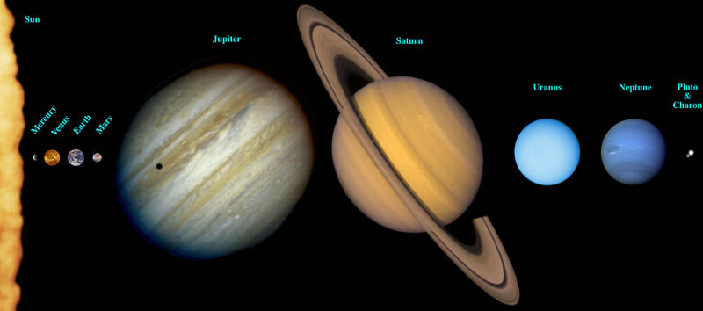

Slide 11
Origin of our Solar System:
Any theory about the origin of our solar system must consider the following six facts:
All the planets revolve around the sun in the same direction.
The paths (orbits) of the planets around the Sun are all nearly circular (slightly elliptical).
Most of the orbits are in nearly the same flat surface (plane).
The Sun turns on its axis (rotates) in almost the same plane as the planets and in the same direction that planets revolve.
Most of the planets rotate in the same direction as the Sun.
Six of the eight planets have moons, most of which revolve around the planets in the same direction that the planets revolve around the sun.

Slide 13
The Protoplanet Hypothesis: (how our Solar system came into existence!)
A huge cloud of gas & dust (NEBULA) began to condense 5 BILLION years ago, possibly due to a nearby exploding star or its own gravity
Most of the cloud’s material gathered at the center and heated up
HYDROGEN FUSION began at the core, creating our Sun
The remaining material circled around the core, and friction caused most of the mass to collect into several large whirlpools of material, called PROTOPLANETS
Protoplanets have grown into the size of the present planets by the process of accretion, where errant dust & gas accumulates on these few (8) surfaces. This is similar to making a snowman, as a snowball collects more debris (snow) to get larger and larger.

